Slide 1
Effective scientific communication
How to do data visualisation in an effective way

Slide 2
Why visualise?
Treatments | Mean x | Mean y | Std dev x | Std dev y | Corr(x,y)
A | 54.3 | 47.8 | 16.8 | 26.9 | -0.1
B | 54.3 | 47.8 | 16.8 | 26.9 | -0.1
C | 54.3 | 47.8 | 16.8 | 26.9 | -0.1
D | 54.3 | 47.8 | 16.8 | 26.9 | -0.1
E | 54.3 | 47.8 | 16.8 | 26.9 | -0.1
F | 54.3 | 47.8 | 16.8 | 26.9 | -0.1
G | 54.3 | 47.8 | 16.8 | 26.9 | -0.1
H | 54.3 | 47.8 | 16.8 | 26.9 | -0.1
I | 54.3 | 47.8 | 16.8 | 26.9 | -0.1
J | 54.3 | 47.8 | 16.8 | 26.9 | -0.1
K | 54.3 | 47.8 | 16.8 | 26.9 | -0.1
L | 54.3 | 47.8 | 16.8 | 26.9 | -0.1
M | 54.3 | 47.8 | 16.8 | 26.9 | -0.1
13 datasets from different “treatments”
If your hypothesis was:
  “There is no difference between these treatments”
  Would you reject or accept?

Slide 3
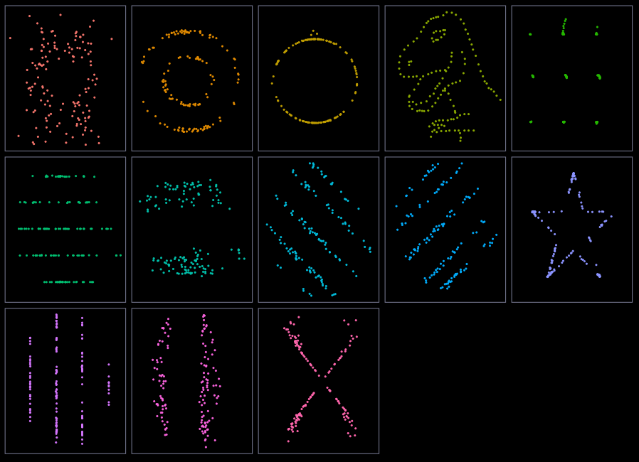
Why visualise?
Treatments | Mean x | Mean y | Std dev x | Std dev y | Corr(x,y)
A | 54.3 | 47.8 | 16.8 | 26.9 | -0.1
B | 54.3 | 47.8 | 16.8 | 26.9 | -0.1
C | 54.3 | 47.8 | 16.8 | 26.9 | -0.1
D | 54.3 | 47.8 | 16.8 | 26.9 | -0.1
E | 54.3 | 47.8 | 16.8 | 26.9 | -0.1
F | 54.3 | 47.8 | 16.8 | 26.9 | -0.1
G | 54.3 | 47.8 | 16.8 | 26.9 | -0.1
H | 54.3 | 47.8 | 16.8 | 26.9 | -0.1
I | 54.3 | 47.8 | 16.8 | 26.9 | -0.1
J | 54.3 | 47.8 | 16.8 | 26.9 | -0.1
K | 54.3 | 47.8 | 16.8 | 26.9 | -0.1
L | 54.3 | 47.8 | 16.8 | 26.9 | -0.1
M | 54.3 | 47.8 | 16.8 | 26.9 | -0.1

Slide 4
Why visualise?
Calculating summary statistics is great
But not sufficient
Summary stats (e.g. means) obscures a lot of information
Visualisations (normally) don’t

Slide 5
When visuals hide information

Slide 6
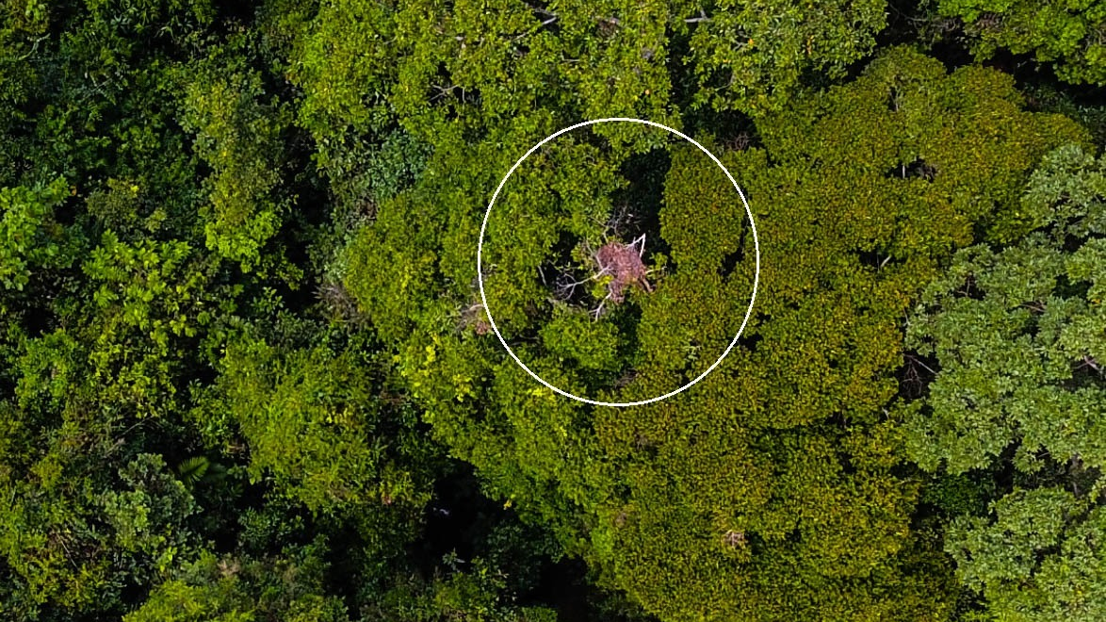
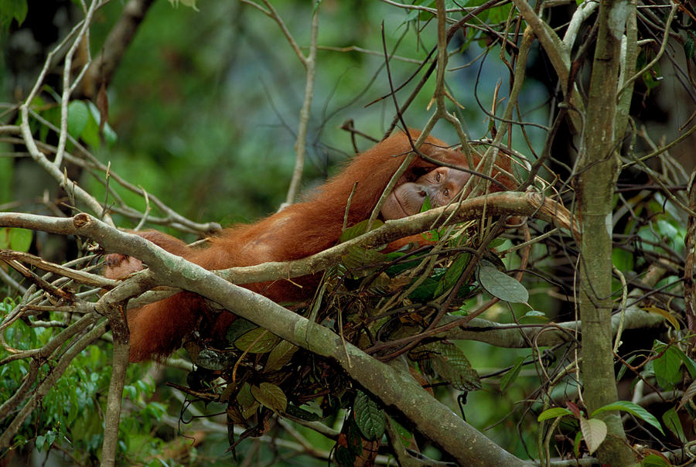

Slide 7
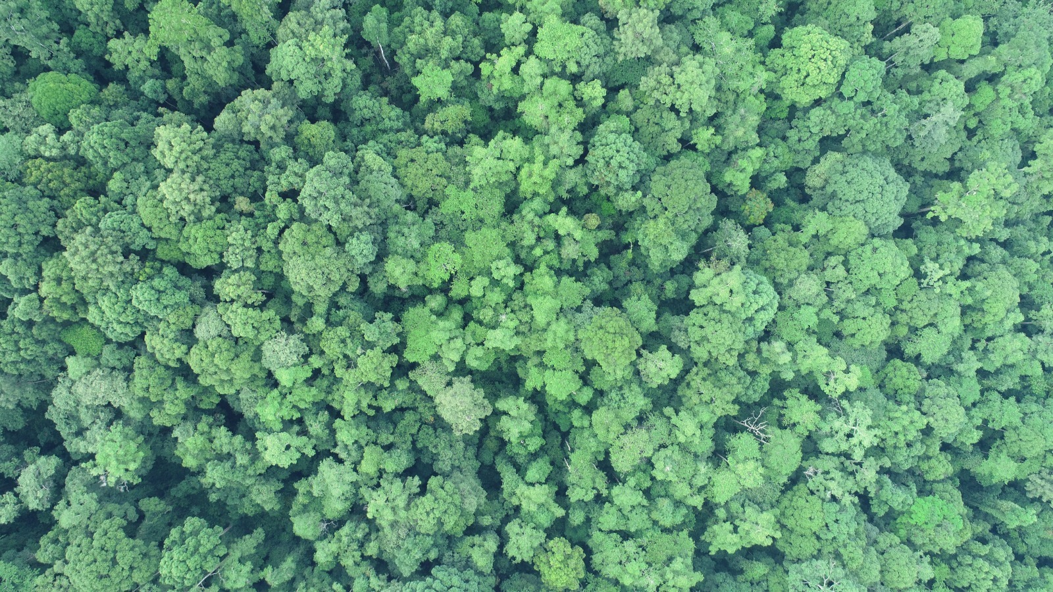

Slide 8
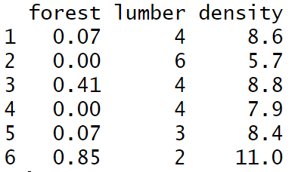
Our research question
How is percentage of old growth forest related to the density of orangutan nests in a 1 ha area?
Is there a relationship?
Is it worth going through the pain of doing statistics?

Slide 9
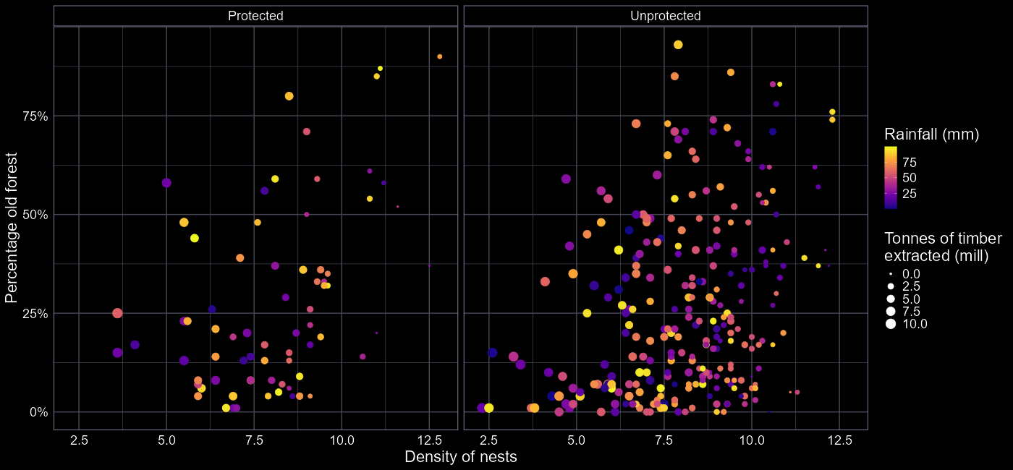
Is there a relationship?

Slide 10
Is there a relationship?
Does density of orangutan nests increase with percentage of old growth forest?

Slide 11
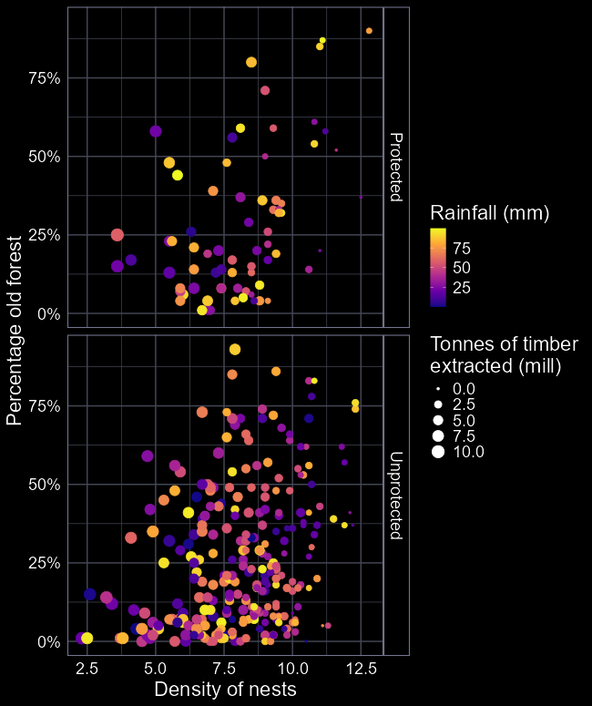
What’s wrong with this figure?
Axes are the wrong way around
Values of colours are hard to read
Size of points are hard to read
Facets add extra complexity
Ultimately, does a poor job of explaining the relationship we want it to explain

Slide 12
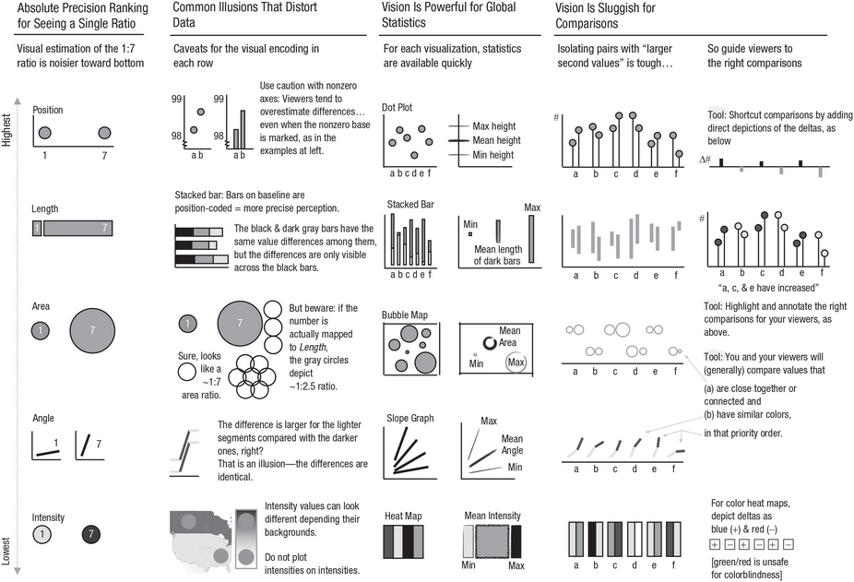
Guidance for effective visualisation

Slide 13
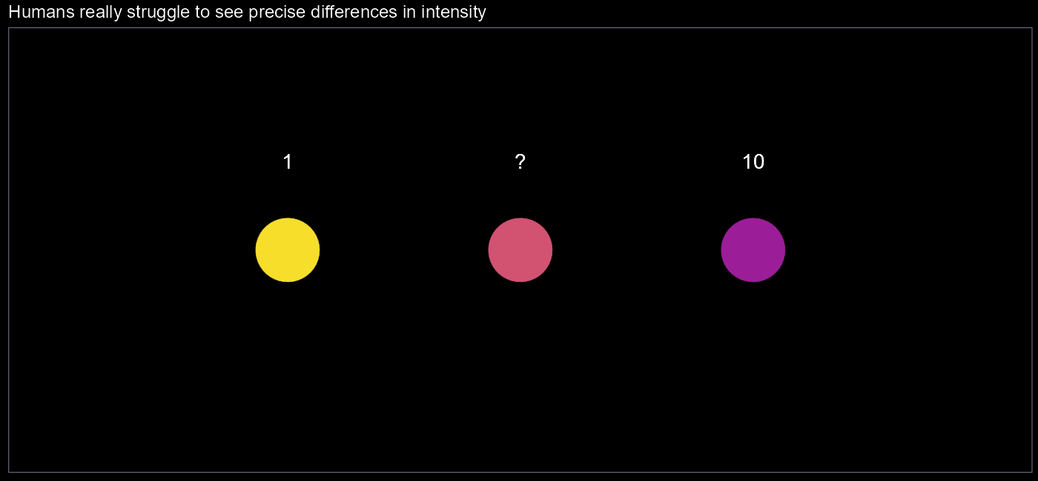

Slide 14
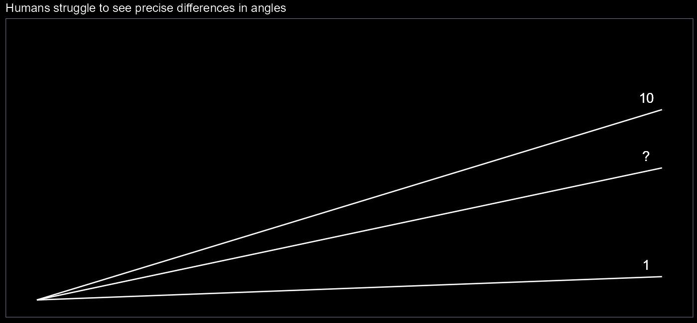

Slide 15
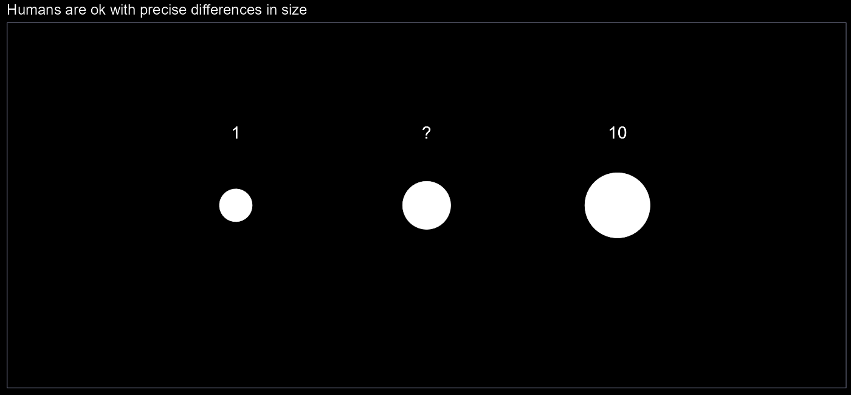

Slide 16
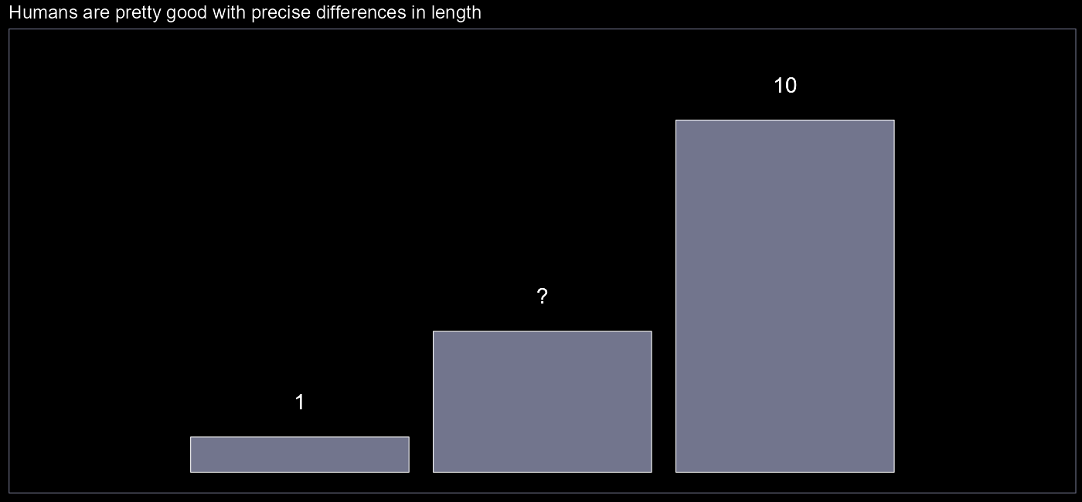

Slide 17
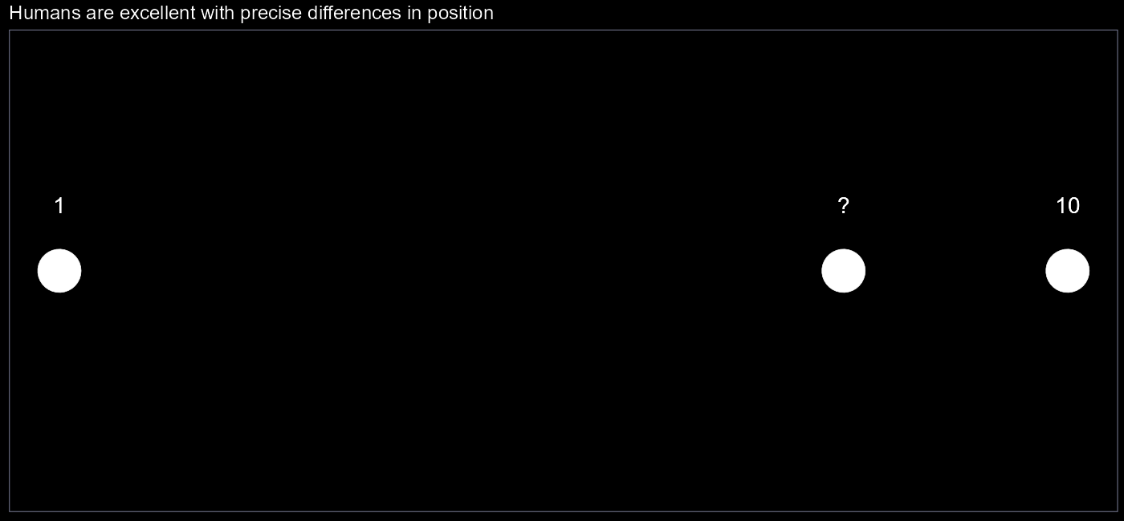

Slide 18
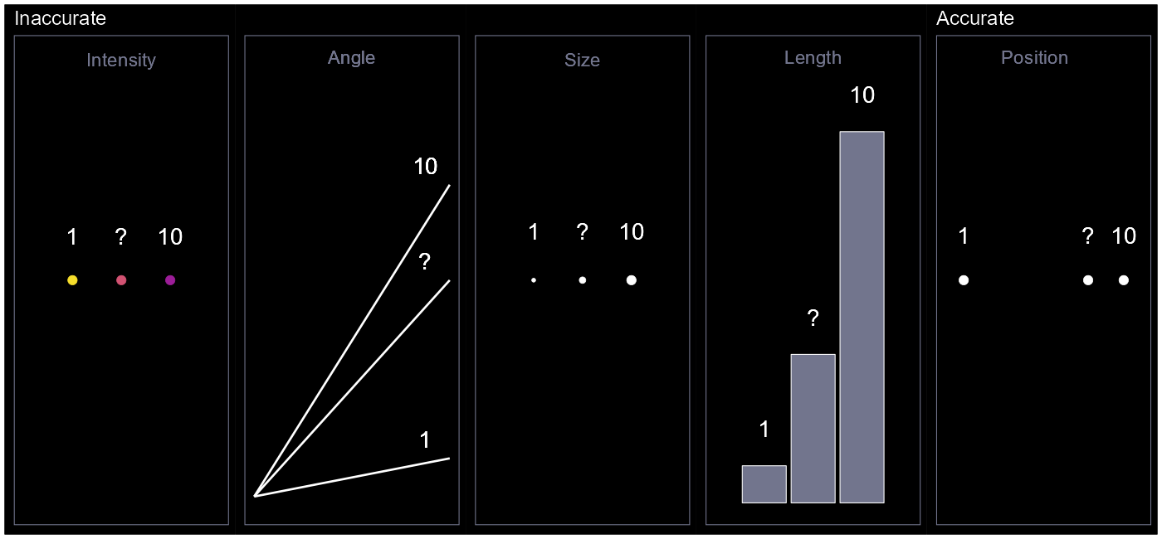





$$?=7$$
$$?=7$$
$$?=3$$
$$?=4$$
$$?=8$$

Slide 19
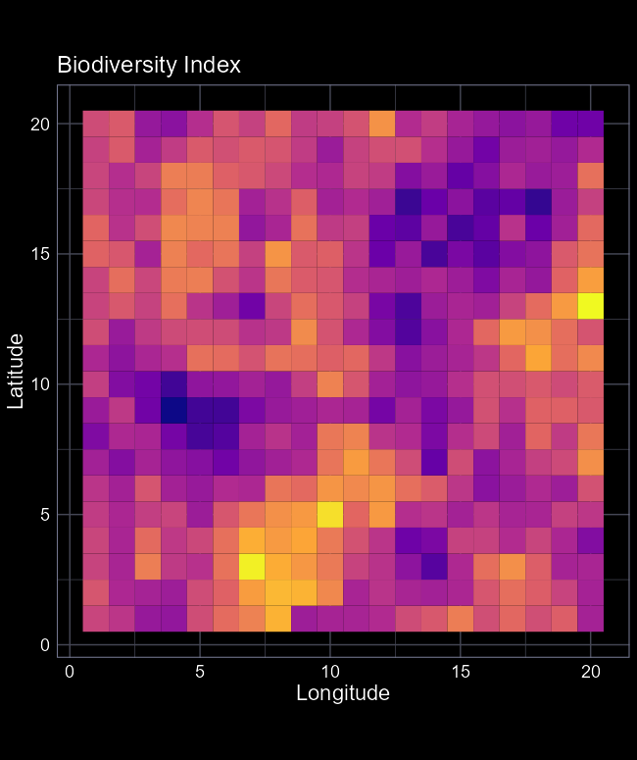
Guidance, not rules
None of the different ways to visualise are always wrong or always right
Depends on the context
Consider what you’re trying to do and use the most appropriate option

Slide 20
Where each fail in their own special way

Slide 21
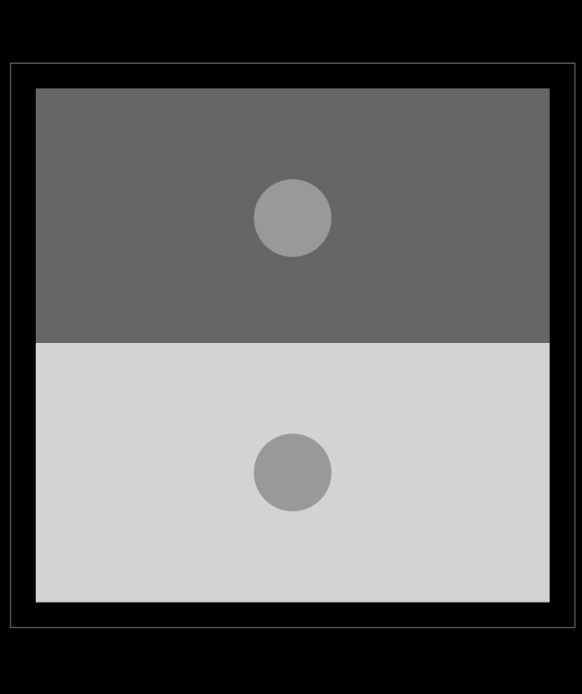
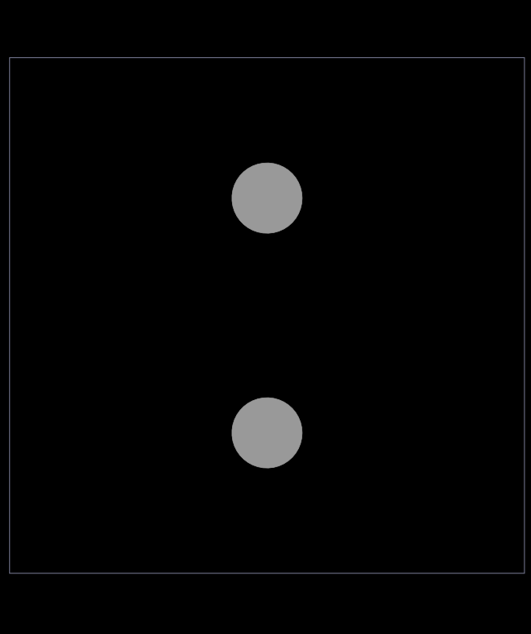
Intensity
The same intensity can look different if plotted on top of another layer of intensity
Avoid using multiple intensities

Slide 22
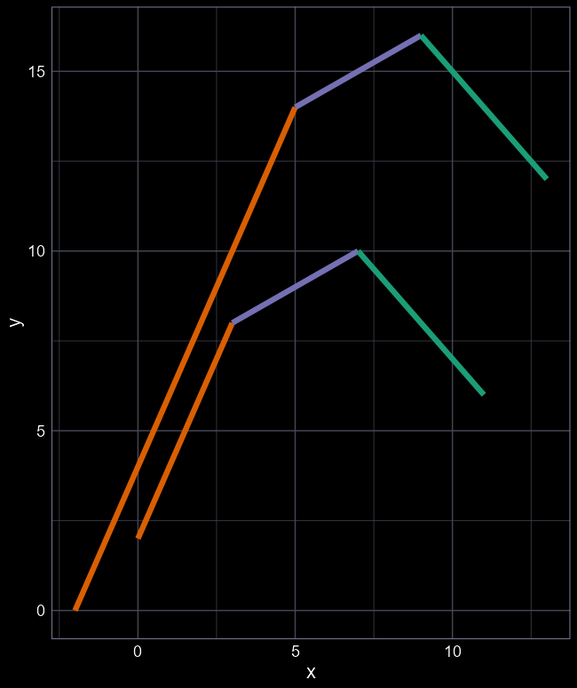
Angle
Are purple angles the same?
Comparing multiple angles can lead to optical illusion where identical angles appear different
All coloured line segments have the same angle

Slide 23
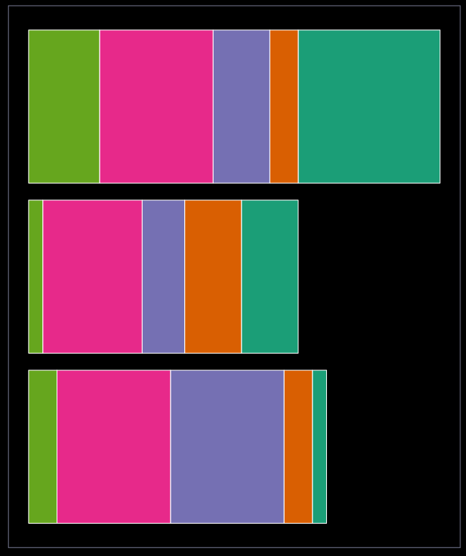
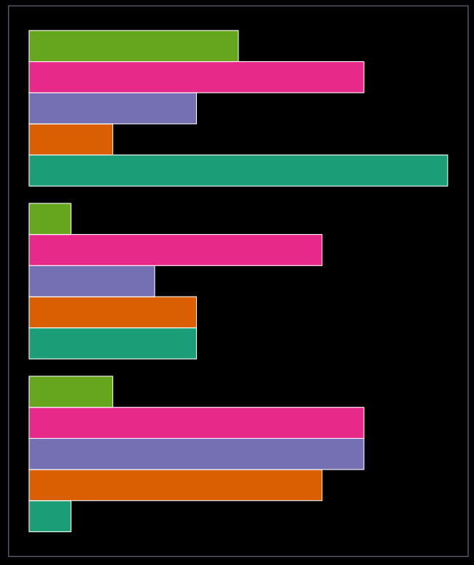
Length
Comparing baselines (puke green) are easy
But comparing other groups is hard (e.g. is orange in top and bottom bars the same?)
Avoid stacking bars on each other

Slide 24
Incorporate concepts

Slide 25
Let’s improve this

Slide 26
What’s should we change?
Response variable on the Y-axis
Reduce the amount of information we are asking the reader to process
  Always make life easy for your reader

Slide 27
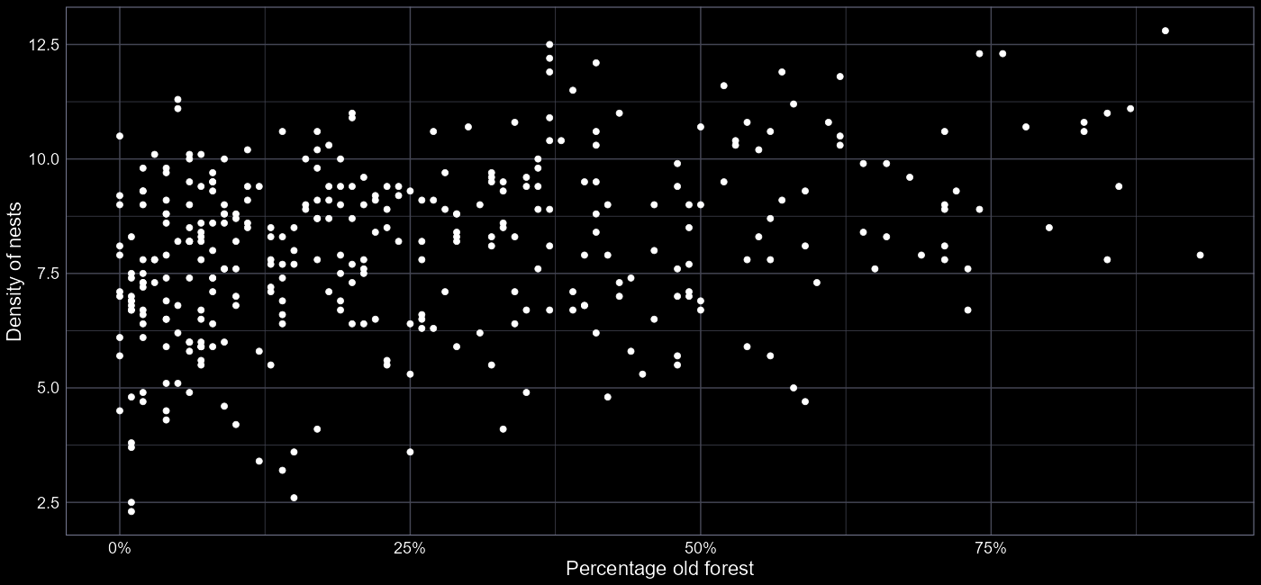
Our improved figure

Slide 28
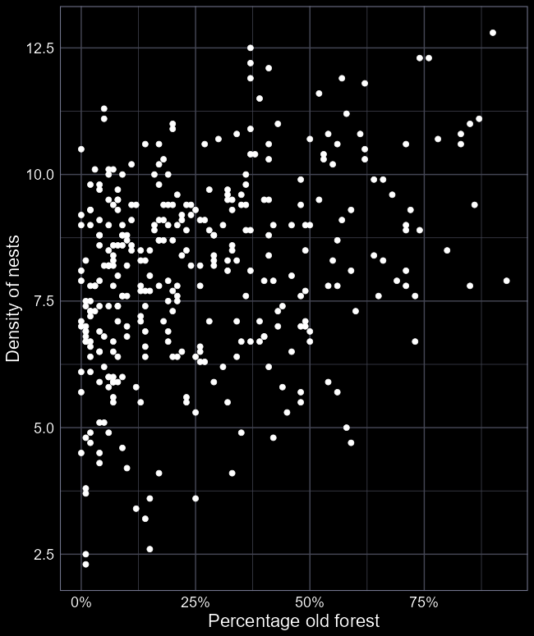
Effective visual communication
Primary objective is to keep the amount of information to an absolute minimum
The more your audience has to think, the less effective you are
KISS; “Keep it simple, stupid”

